Slide 1



INTEGRATED CIRCUITS AND SYSTEMS DESIGN
PROJECT: RAM ARBITER
ĐỖ MẠNH DŨNG
TRỊNH LÊ MINH HIẾU
PHẠM TRẦN MINH
ĐẶNG TRUNG NGHĨA
- 21119301
- 21119011
- 21119023
- 21119313

Slide 2
TABLE OF CONTENTS
PART B: MAIN CONTENT
PART A: INTRODUCTION
1. TOP LEVEL BLOCK DIAGRAM
1.1. BLOCK DIAGRAM OF RAM ARBITER
4. RAM ARBITER
4.1. PORT MAP IN BETWEEN RAM AND ARBITER
4.2. CODING
4.3. SCHEMATIC OF RAM ARBITER
4.4.TEST CASES FOR RAM ARBITER
4.5. VERILOG TESTBENCH
4.5.1. TESTBENCH CODE
4.5.2. ANALYSIS OF THE TEST CASES
4.6. POWER & TIMING
2. RAM
2.1. BLOCK DIAGRAM OF RAM
2.2. CODING
2.3. SCHEMATIC OF RAM
2.4.TEST CASES FOR RAM
2.5. VERILOG TESTBENCH
2.5.1. TESTBENCH CODE
2.5.2. ANALYSIS OF THE TEST CASES
2.5.3. POWER & TIMING
PART C: CONCLUSION
PART D: REFERENCES
3. ARBITER
3.1. FSM
3.1.1. BLOCK DIAGRAM
3.1.2. FSM DESIGN BLOCK
3.1.3. CODING
3.1.4. SCHEMATIC
3.2 ARBITER
3.2.1. BLOCK DIAGRAM
3.2.2. CODING
3.2.3. SCHEMATIC
3.2.4. TEST CASE
3.2.5. VERILOG TESTBENCH
3.2.5.1. TESTBENCH CODE
3.2.5.2. ANALYSIS OF THE TEST CASES
3.2.6. FPGA
3.2.7. POWER & TIMING

Slide 3

PART A: INTRODUCTION

Slide 4
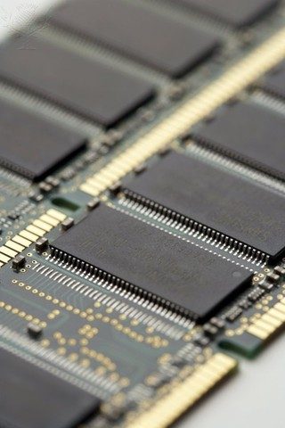
1.1. Problem Statement:
In today's world, with the prevalence of electronic systems and computers, managing memory access becomes a challenge for designers. In an asynchronous environment, where there is no common clock to synchronize events, ensuring efficient and fair memory access becomes a complex issue.
One of the significant challenges arises from concurrently managing multiple memory access requests from different components. When multiple parts of the system simultaneously request access to the memory, deciding which request takes priority becomes crucial. This raises the issue of designing an effective Arbiter, a component that determines which component is allowed memory access and when.

Slide 5
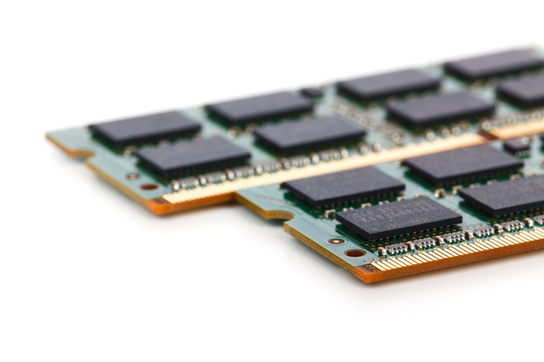
1.2. Problem Resolution:
To address these challenges, the project "Designing RAM Arbiter" focuses on researching and developing an intelligent and flexible Arbiter. The Arbiter will ensure that every memory access request is handled fairly, stably, and efficiently.
Through the research process, we will explore methods and algorithms to make informed decisions when multiple requests coincide. The goal is to build an Arbiter with flexible responsiveness, minimizing conflicts and ensuring that every system component has an opportunity for efficient memory access.
This project is not only technically oriented but also an opportunity to contribute to the development of asynchronous systems and memory management. It provides a practical solution to one of the most critical issues in this field.

Slide 6
PART B: MAIN CONTENT

Slide 7
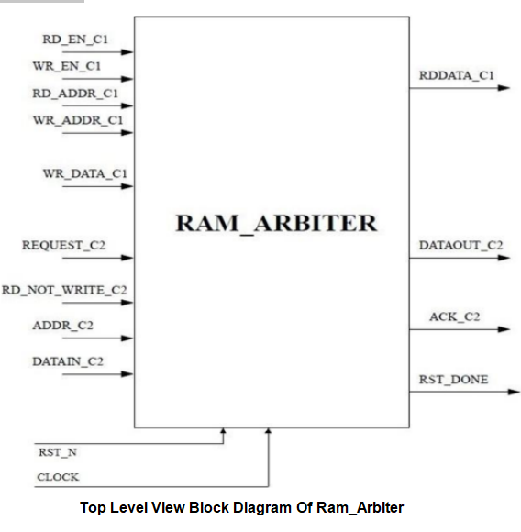
1. TOP LEVEL BLOCK

Slide 8
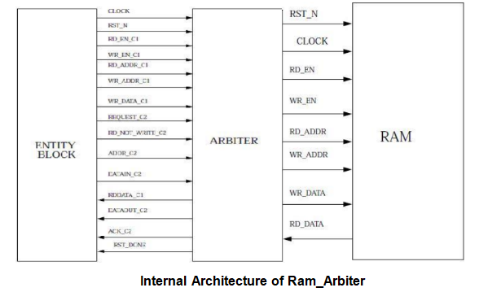
1. TOP LEVEL BLOCK

Slide 9
2. RAM

Slide 10
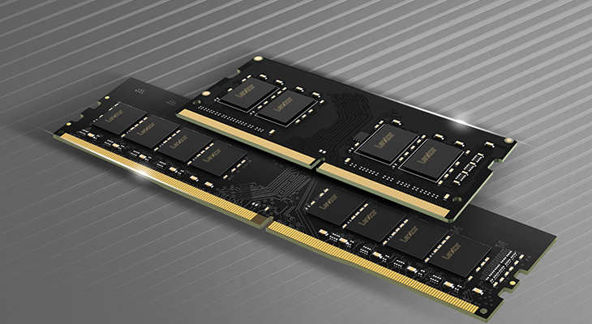
2.RAM
RAM stands for "Random Access Memory." It is a type of computer memory used to temporarily store data and provide quick access to the processor. Data in RAM can be read and written quickly, and it retains data only as long as the computer is powered on. When the computer is turned off or restarted, the data in RAM is lost.
RAM is primarily used to store programs and data that the processor is currently or will soon be using, and it is designed to provide fast access to this information. In modern applications and operating systems, having a larger RAM capacity often contributes to smoother computer performance and faster processing.

Slide 11
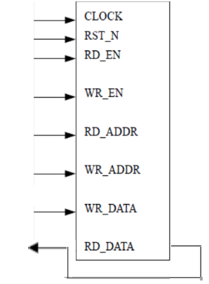
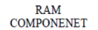
2.1. BLOCK DIAGRAM OF RAM
In Random Access Memory (RAM), the memory cells can be accessed for information transfer from any desired random location.
That is the process of locating a word in memory is the same and requires an equal amount of time no matter where the cells are located physically in memory: thus the name “Random Access“
Communication between memory and its environment is achieved through data input and output lines, address selection lines, and control lines that specify the direction of transfer
A block diagram of a RAM unit is shown below figure:

Slide 12
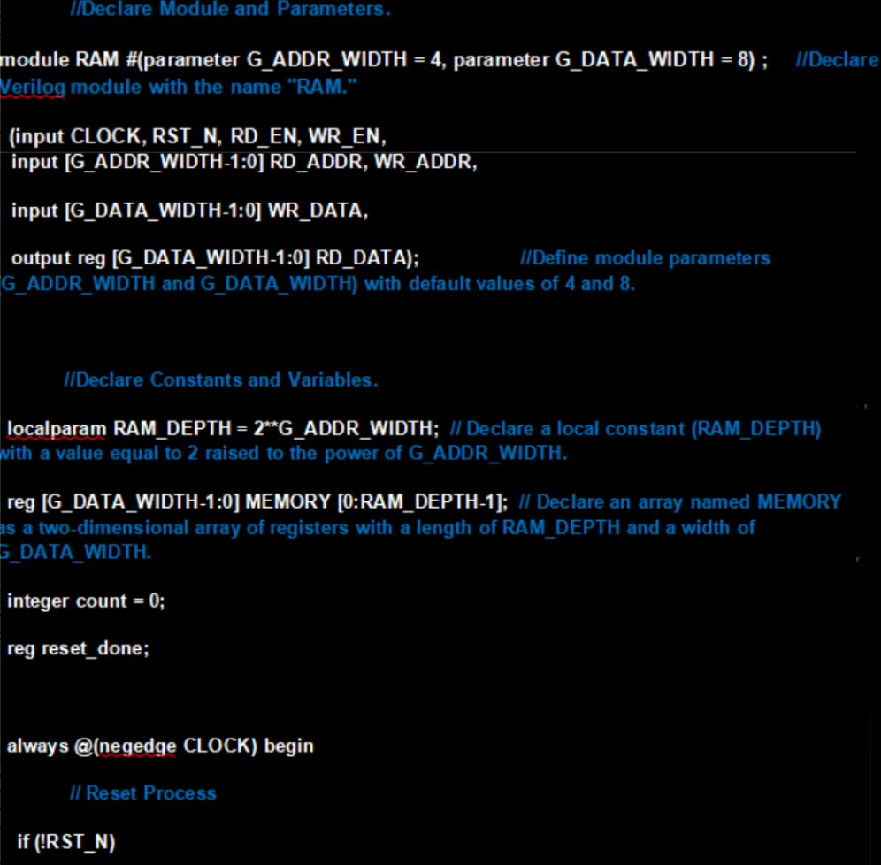
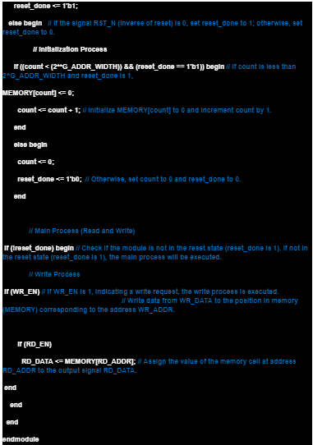
2.2 CODING

Slide 13
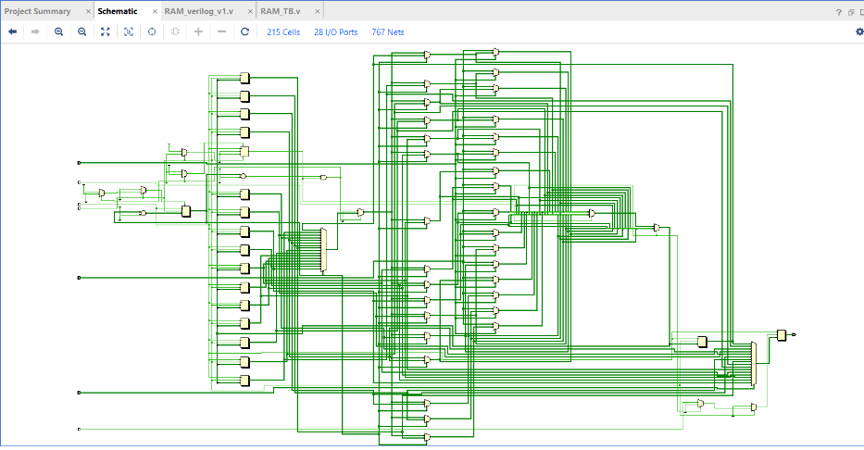
2.3 SCHEMATIC OF RAM

Slide 14
2.4 TEST CASES FOR RAM
Case 1: RAM write operation
Case 2: RAM read operation
Case 3: RAM read & write operation

Slide 15
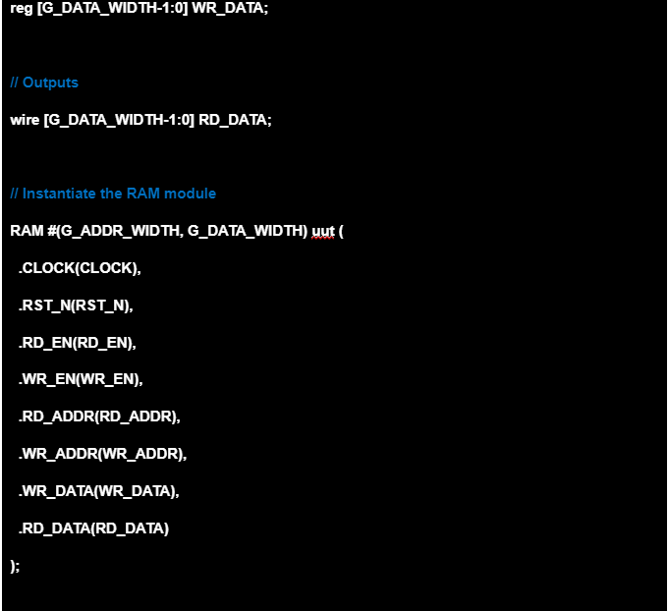
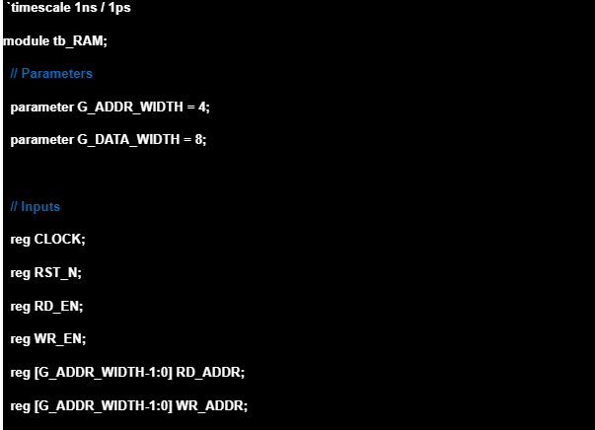
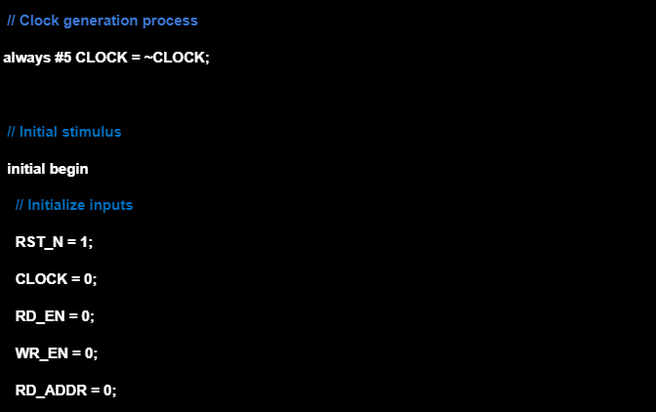
2.5. VERILOG TESTBENCH
2.5.1. TESTBENCH CODE

Slide 16
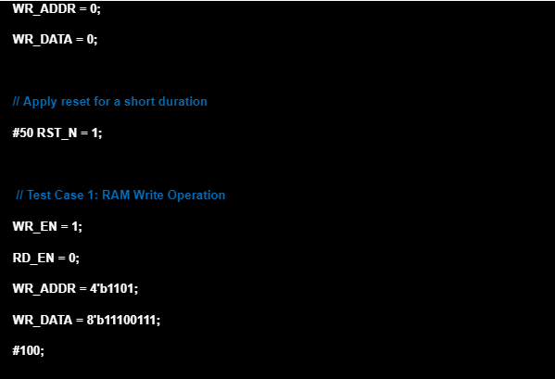
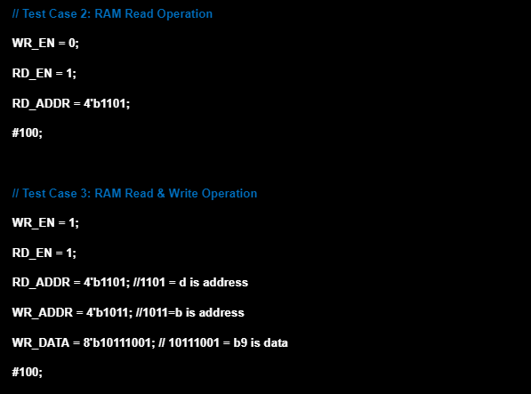

2.5. VERILOG TESTBENCH
2.5.1. TESTBENCH CODE

Slide 17
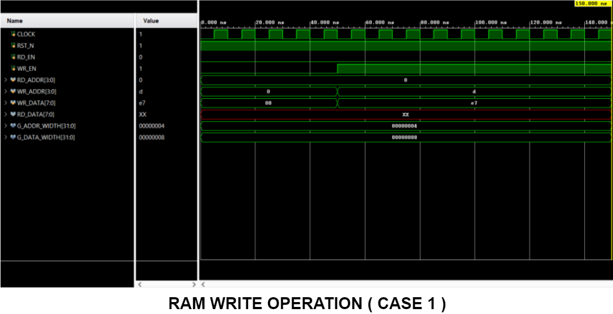
2.5. VERILOG TESTBENCH

Slide 18
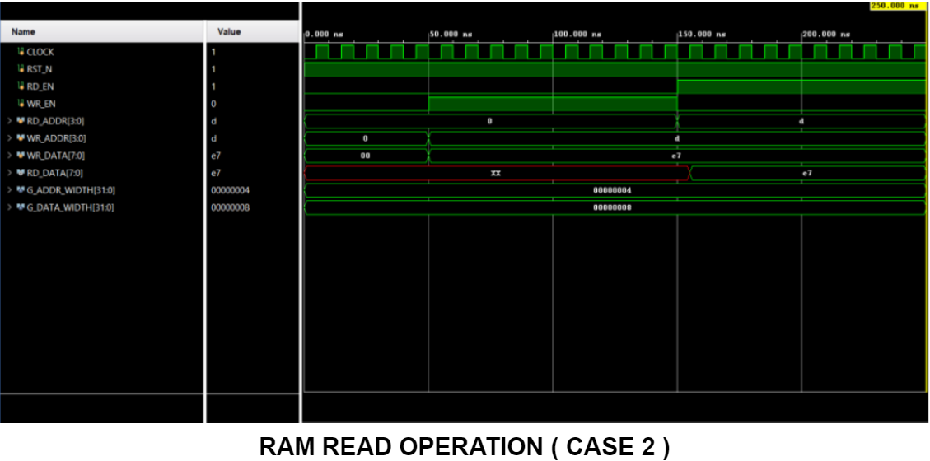
2.5. VERILOG TESTBENCH

Slide 19
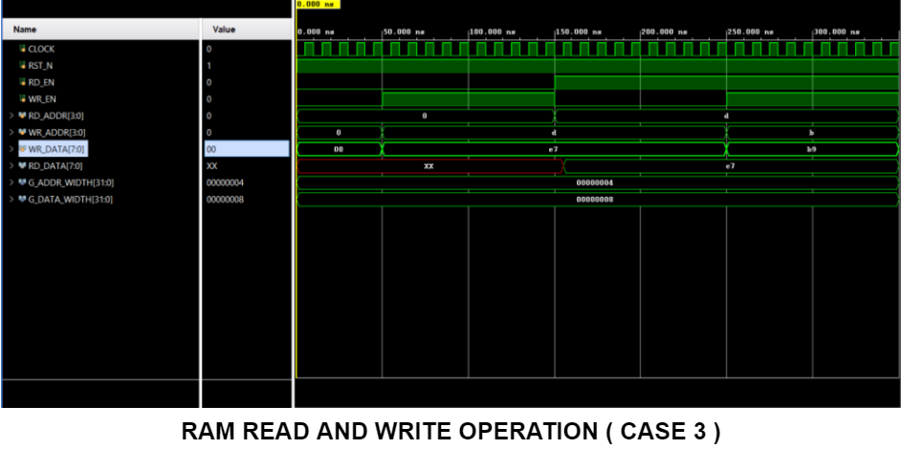
2.5. VERILOG TESTBENCH

Slide 20
2.5. VERILOG TESTBENCH
2.5.2. ANALYSIS OF THE TEST CASES
Case 1: Write Operation
In this case, within the first RAM cycle, it is initialized and the write operation is
performed at the address location “1101 ( binary ) = d ( hex )”. The data written is “11100111 = e7 ( hex )”. The RAM starts working when the RST_N pin is enabled.
Case 2: Read Operation
Similar to the previous condition, when the RST_N pin is enabled within the first RAM cycle, data is read from the address location “1101 ( binary ) = d ( hex )”.
Case 3: Read and Write Operation
In this instance, a HIGH setting on the reset pin activates the RAM. The data "11100111( binary ) = e7 ( hex )" is written to the address "1101 ( binary ) = d ( hex)" in the first RAM cycle. We aim to demonstrate that the RAM design could handle both read and write operations in a single RAM cycle in the second RAM cycle. While data "10111001 ( binary ) = b9 ( hex )" was being written at the address location "1011 ( binary ) = b ( hex )," data was being read from location "1101".

Slide 21
2.5. VERILOG TESTBENCH
2.5.3. POWER & TIMING
Power:
Dynamic Power: It is the energy consumed during the transition of states from 0 to 1 or vice versa. This occurs when flip-flops change states or when transistors switch states during computation.
Static Power: It is the energy consumed even when the circuit is not active (no dynamic transitions). The main cause is due to the leakage current of transistors and other energy loss.
Setup Time and Hold Time:
Setup time is the time before a synchronous signal changes that the input data needs to be stable.
Hold time is the time after a synchronous signal changes that the input data needs to be held stable.

Slide 22
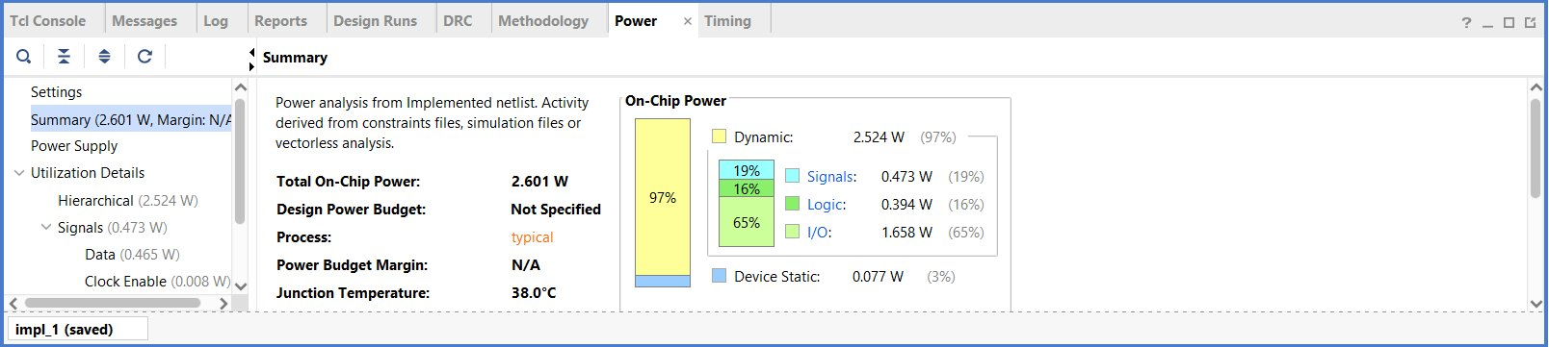
2.5. VERILOG TESTBENCH
2.5.3. POWER & TIMING
POWER OF RAM

Slide 23
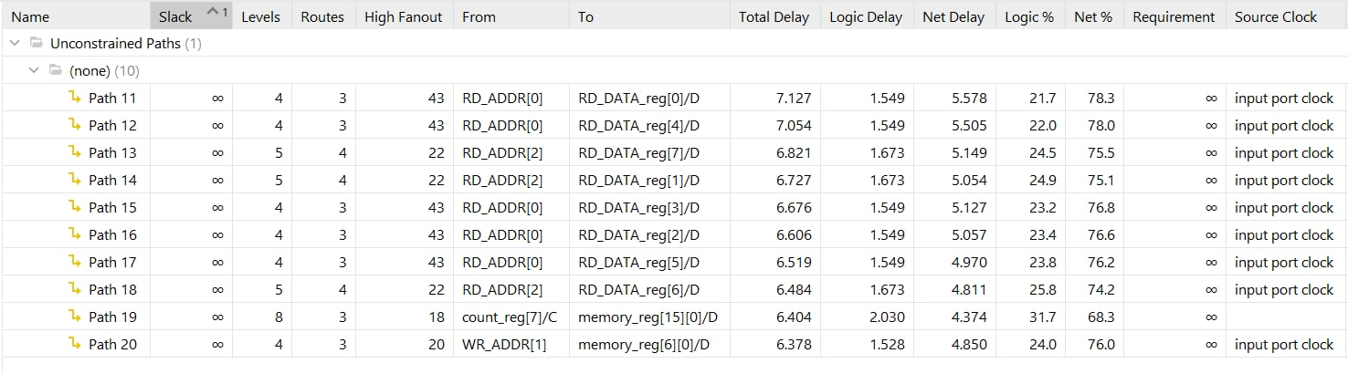
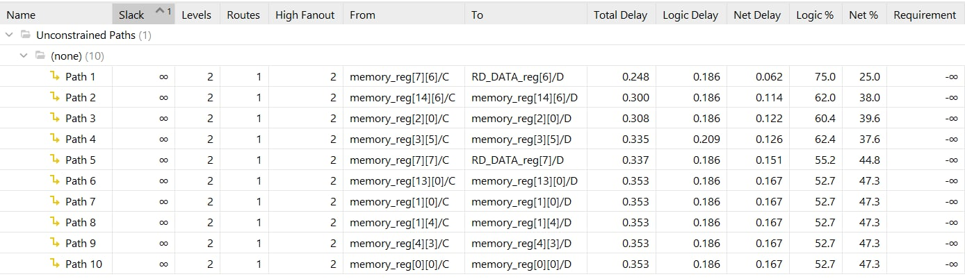
2.5. VERILOG TESTBENCH
2.5.3. POWER & TIMING
SET UP TIME
HOLD TIME

Slide 24
3. ARBITER

Slide 25
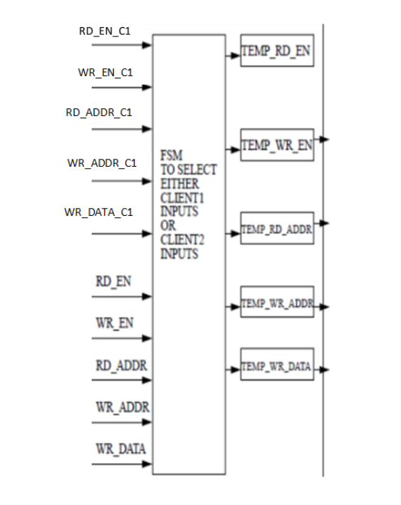
3.1. FSM
3.1.1. BLOCK DIAGRAM
In the Arbiter circuit, FSM (Finite State Machine) refers to a finite state model used to manage the different states of the Arbiter. This model determines how the Arbiter responds to events and controls the process of accessing memory.
The FSM in the Arbiter can have states such as IDLE (Waiting state), Client1_Read (Reading state from Client1), Client1_Write (Writing state from Client1), etc. The transition rules of the FSM define how the Arbiter transitions from one state to another based on events from the clients.

Slide 26
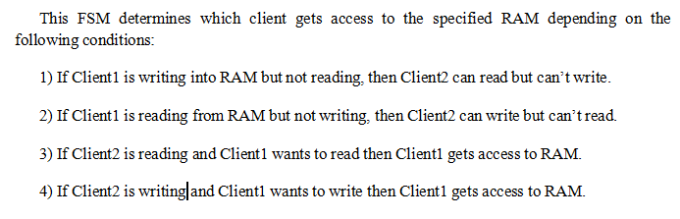
3.1. FSM
3.1.2. FSM DESIGN BLOCK

Slide 27
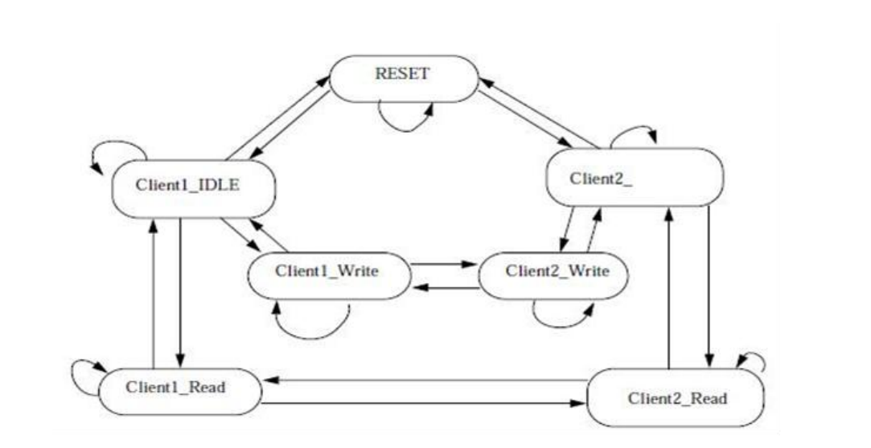
3.1. FSM
3.1.2. FSM DESIGN BLOCK
1. IDLE----->Client1_Read==> RD_EN_C1=1.
2. Client1_Read----->IDLE==> RD_EN_C1=0.
3. IDLE---->Client1_Write==> WR_EN_C1=1.
4. Client1_Write---->IDLE==> WR_EN_C1=0.
5. IDLE--->Client2_Read==> RD_EN_C1=0 and REQUEST_C2=1 and
RD_NOT_WRITE_C2=1.
6. Client2_Read--->IDLE==>REQUEST_C2=0 or REQUEST_C2=1 and
RD_NOT_WRITE_C2=0.
7. IDLE--->Client2_Write==>WR_EN_C1=0 and REQUEST_C2=1 and
RD_NOT_WRITE_C2=0.
8. Client2_Write-->IDLE==>REQUEST_C2=0 or REQUEST_C2=1 and
RD_NOT_WRITE_C2=1.
9. Client2_Read---->Client1_Read===>RD_EN_C1=1.
10. Client1_Read----->Client2_Read===>RD_EN_C1=0 and REQUEST_C2=1 and
RD_NOT_WRITE_C2=1.
11. Client2_Write----->Client1_Write==>WR_EN_C1=1.
12. Client1_Write----->Client2_Write==>WR_EN_C1=0 and REQUEST_C2=1 and
RD_NOT_WRITE_C2=0.
13. Client1_Read--->Client1_Read==>RD_EN_C1=1.
14. Client1_Write--->Client1_Write==>WR_EN_C1=1.
15. Client2_Read--->Client2_Read===>REQUEST_C2=1 and RD_NOT_WRITE_C2=1
and RD_EN_C1=0.
16. Client2_Write---->Client2_Write===>REQUEST_C2=1 and
RD_NOT_WRITE_C2=0 and WR_EN_C1=0.
17. IDLE---->IDLE===>RD_EN_C1=0 and WR_EN_C1=0 and REQUEST_C2=0.
18. RESET--->RESET===>if RST_N=0 holds or RST_N=0 for once and RST_DONE=0
19. RESET--->IDLE===>RST_N=1 and RST_DONE=1.
20. IDLE--->RESET==>RST_N=0.
IDLE

Slide 28
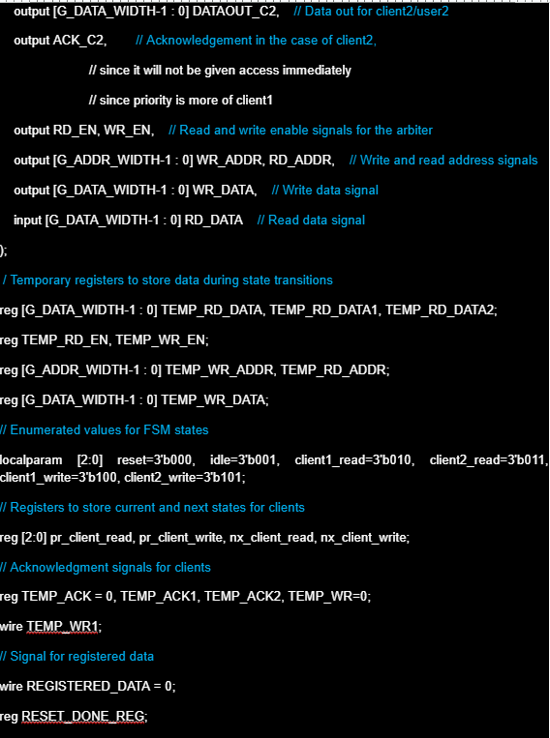
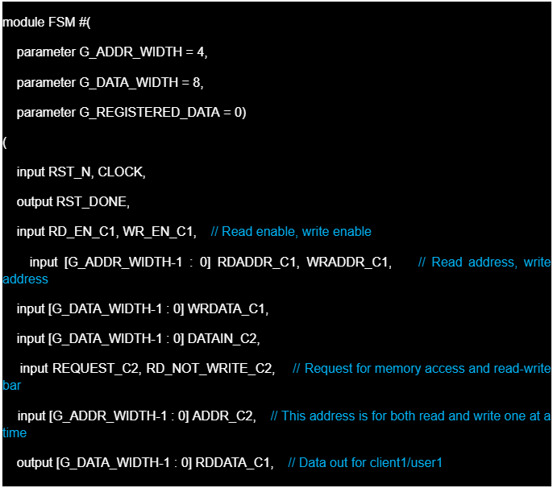
3.1. FSM
3.1.3. CODING

Slide 29
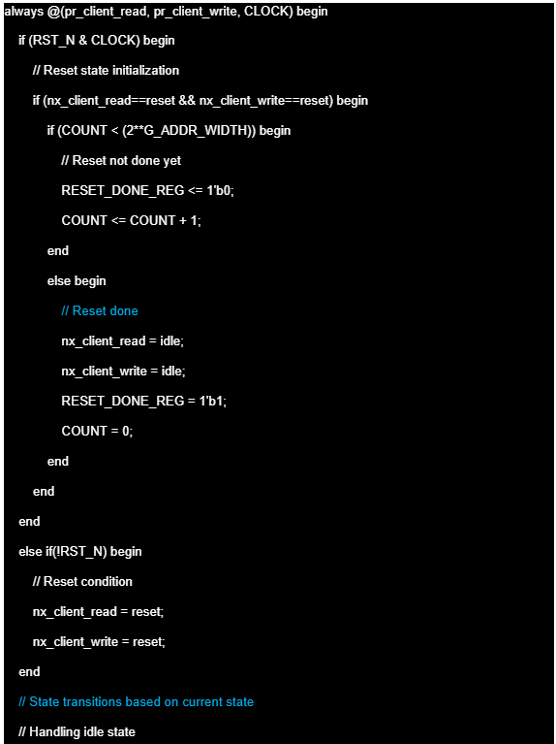
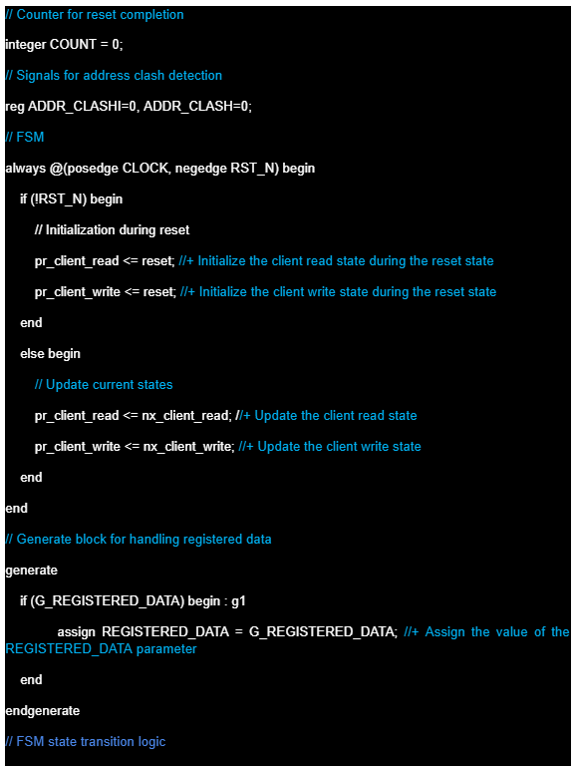
3.1.3. CODING

Slide 30
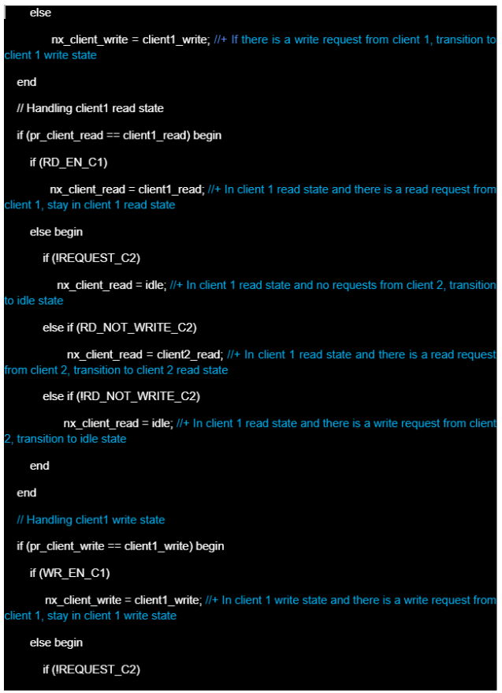
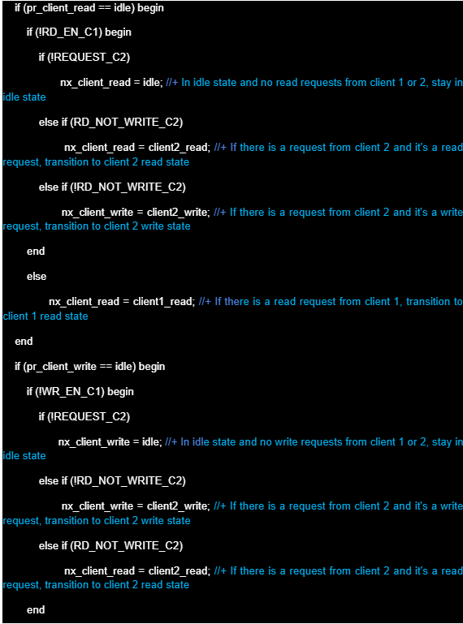
3.1.3. CODING

Slide 31
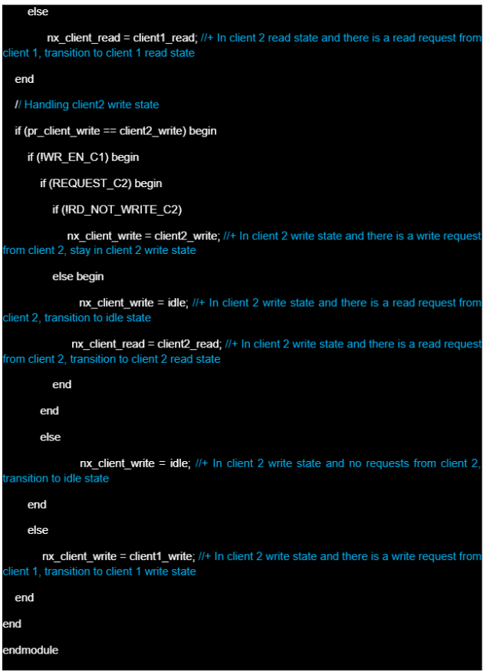
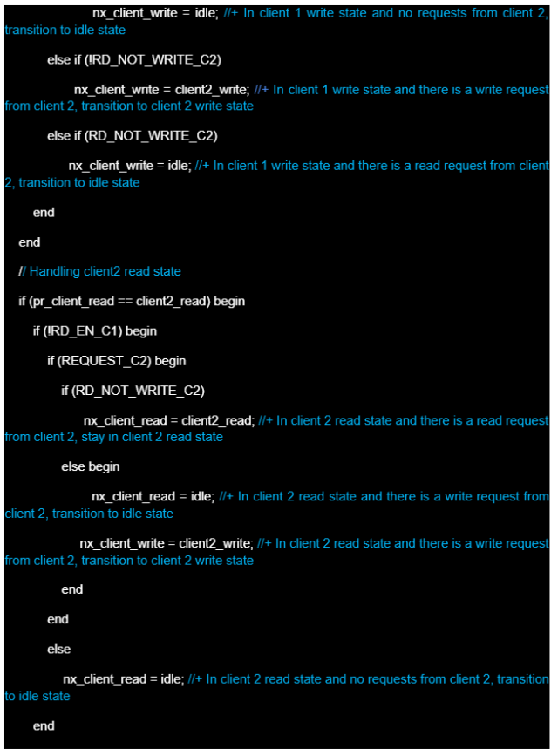
3.1.3. CODING

Slide 32
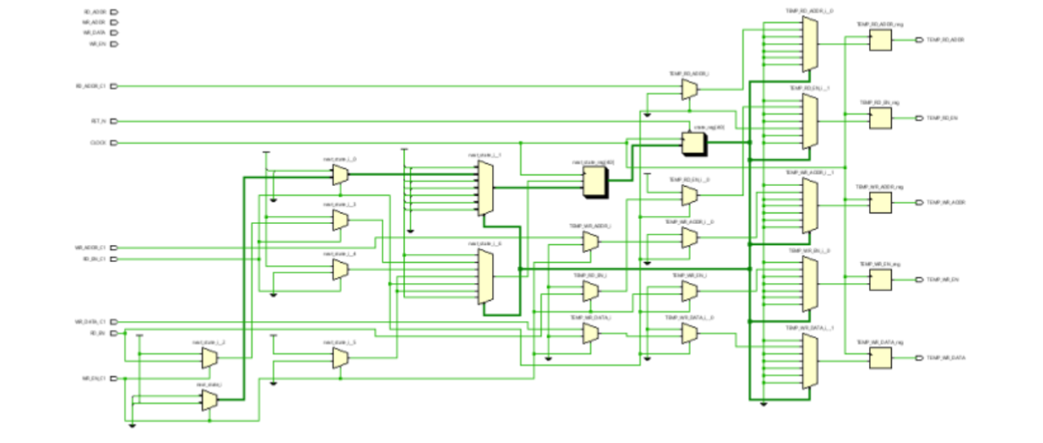
3.1.4. SCHEMATIC

Slide 33
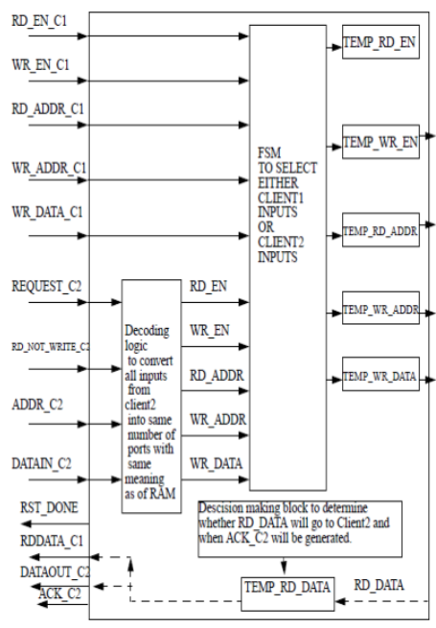
3.2. ARBITER
An arbiter circuit performs another task essential for asynchronous computers. An Arbiter is like a traffic officer at an intersection who decides which car may pass through next.
Given only one request, an Arbiter promptly permits the corresponding action, delaying any second request until the first action is completed. When an Arbiter gets two requests at once, it must decide which request to grant first.
3.2.1. BLOCK DIAGRAM

Slide 34
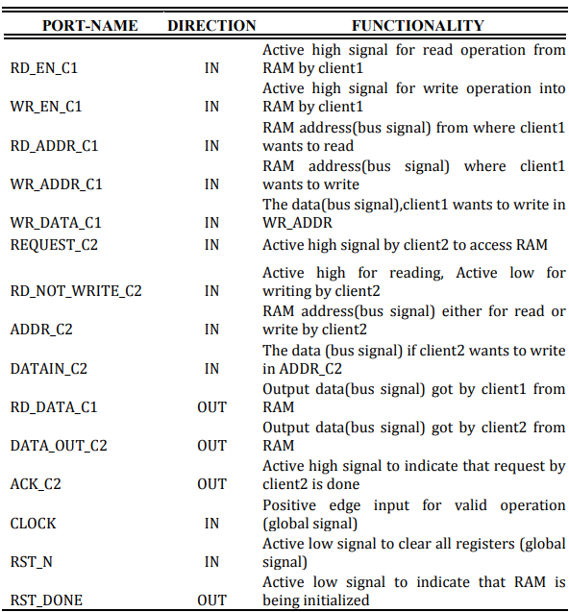

Slide 35
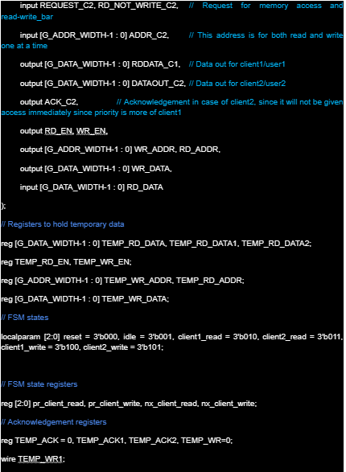
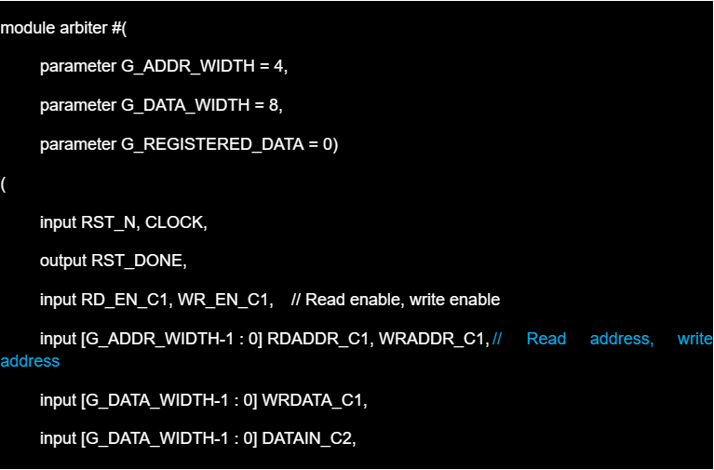
3.2. ARBITER
3.2.2. CODING

Slide 36
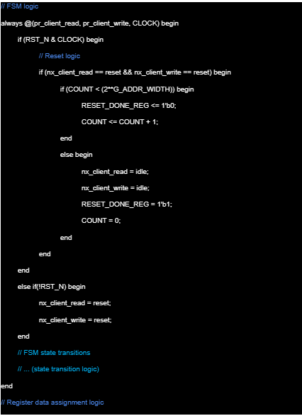
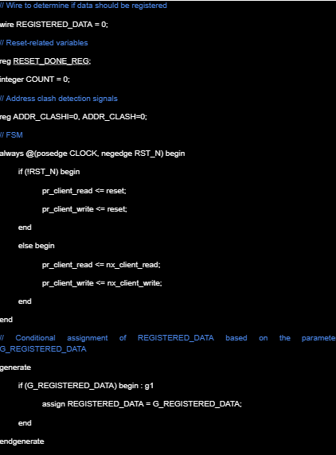
3.2.2. CODING

Slide 37
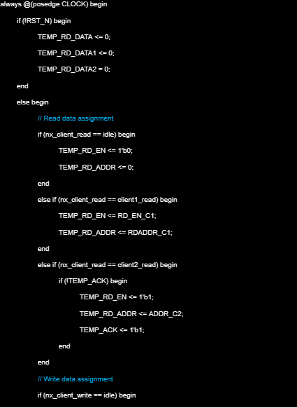
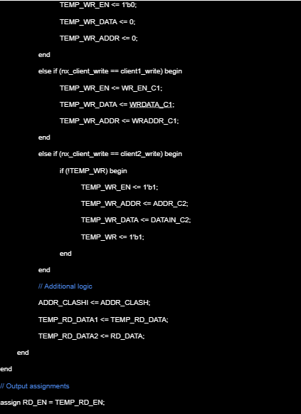
3.2.2. CODING

Slide 38
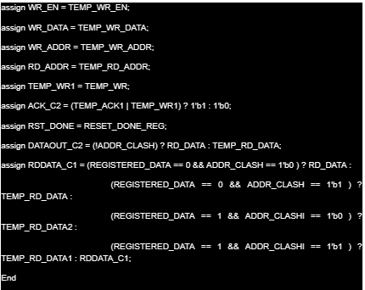
3.2.2. CODING

Slide 39
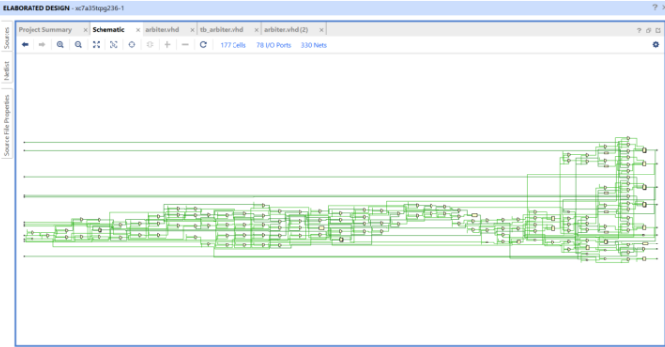
3.2.3. SCHEMATIC
Schematic of Arbiter

Slide 40
3.2.4. TEST CASE
Case 1: Only Client1 wants to write.
Case 2: Only Client1 wants to read
Case 3: Only Client2 wants to write
Case 4: Only Client2 wants to read

Slide 41
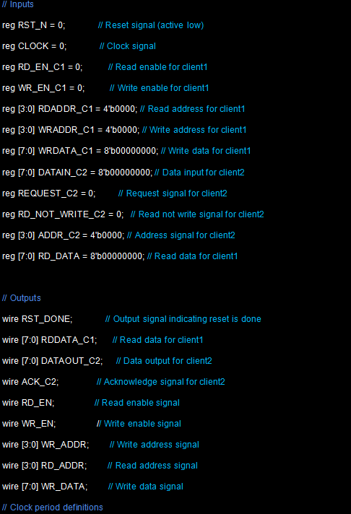
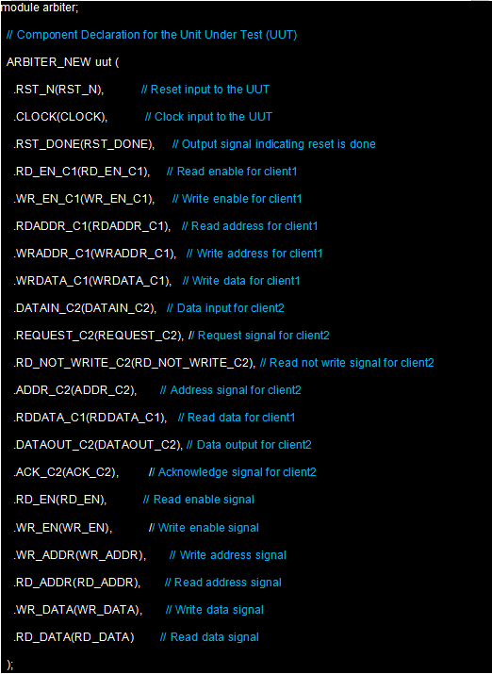
3.2.5. VERILOG TESTBENCH
3.2.5.1. TESTBENCH CODE

Slide 42
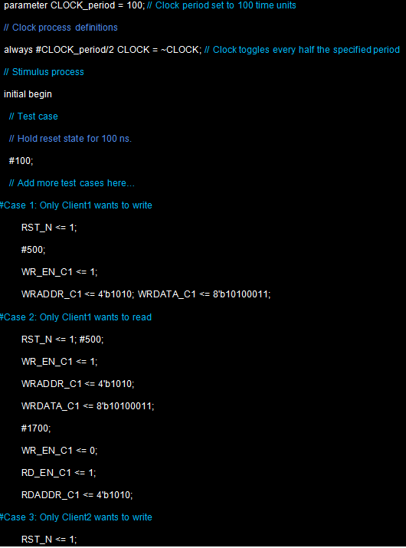
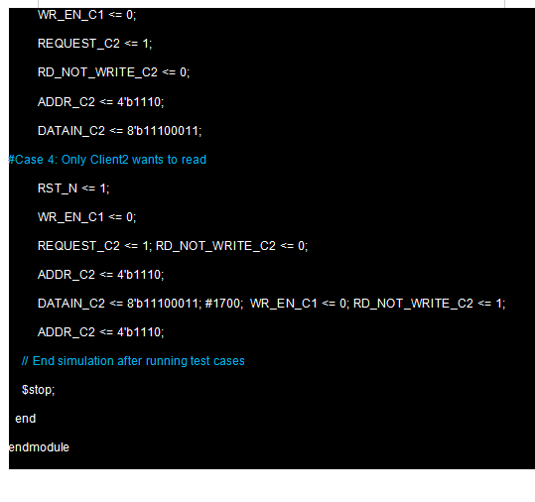
3.2.5. VERILOG TESTBENCH
3.2.5.1. TESTBENCH CODE

Slide 43
3.2.5. VERILOG TESTBENCH
3.2.5.2. ANALYSIS OF THE TEST CASES
Case1: Only Client1 wants to write.
In this case, when the RST_N pin is enabled, the arbiter starts its operation. Within the first RAM_DEPTH cycle, Client1 enables its WR_EN_C1 pin and writes the data “ a3 ” at the address location “ a ”. The arbiter places the data it received, on the input pins of the RAM i.e. the WR_ADDR receives the address location and the WR_DATA receives the data.
Case 2: Only Client1 wants to read.
The Arbiter starts working as soon as the RST_N pin is enabled. The clock period is set to 50ns. Within the first RAM_DEPTH cycle, a data “ a3 ” is written at the location “ a ”. The R_EN_C1 pin is enabled to facilitate the operation. During the next RAM_DEPTH cycle, Client1 wishes to read at the RAM location “ a ” by enabling the RD_EN_C1 pin.

Slide 44
3.2.5. VERILOG TESTBENCH
3.2.5.2. ANALYSIS OF THE TEST CASES
Case3: Only Client2 wants to write.
Here in this case, the Arbiter starts working as soon as the RST_N pin is set high. The clock period is set to 50 ns. As the arbitration scheme used is a priority based one, so Client2 needs to issue a signal on the REQUEST_C2 pin in order to access the RAM. Here the priority is given to Client1.Within the first RAM_DEPTH cycle, REQUEST_C2 pin is enabled to allow Client2 to access the RAM. Client2 uses two states of a single pin RD_NOT_WRITE to perform both of its read and write operation. This pin only works if REQUEST_C2 pin is enabled. Upon enabling REQUEST_C2, RD_NOT_WRITE is set to low to allow for the write operation. Data “ e3 ” is written at the location “ e ”. The arbiter acknowledges the write operation by setting up periodic pulses at the ACK_C2 output pin.
Case 4: Only Client2 wants to read.
In this case, within the first RAM_DEPTH cycle, data “ e3 ” is written in the address location “ e ” by enabling the REQUEST_C2 pin and setting RD_NOT_WRITE pin to an active low state. However in the second RAM_DEPTH cycle, Client2 activates the high signal on RD_NOT_WRITE pin and issue a signal to the arbiter to read from location “ e ”. The read operation is acknowledged by the Arbiter by issuing clock pulses at the ACK_C2 pin whose clock period is two times that of the former one.

Slide 45
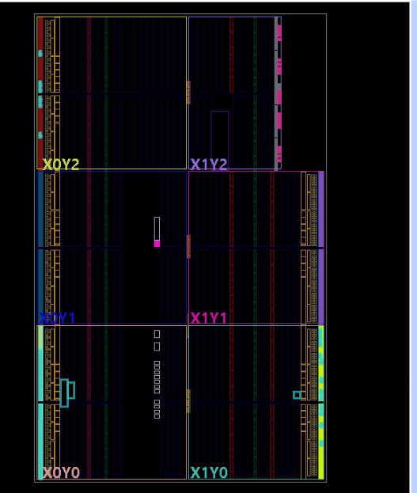
3.2.6. FPGA

Slide 46
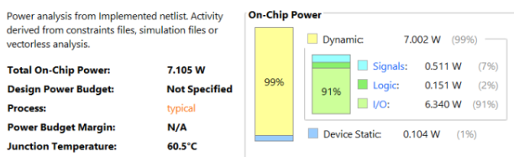
3.2.7. POWER & TIMING

Slide 47
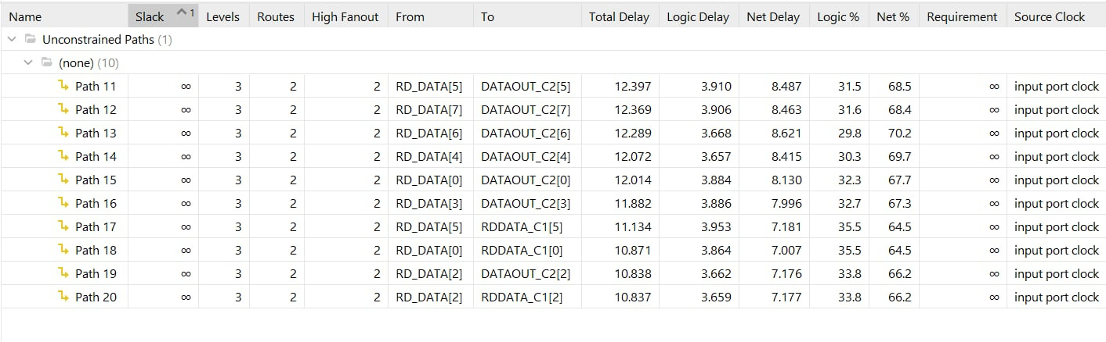

3.2.7. POWER & TIMING
SET UP TIME
HOLD TIME

Slide 48
4.RAM ARBITER

Slide 49

4.1. Port Map in between RAM and Arbiter
Port Map between RAM & Arbiter

Slide 50


4.2. CODING

Slide 51


4.2. CODING

Slide 52

4.3. SCHEMATIC OF RAM ARBITER

Slide 53

FPGA

Slide 54
4.4.TEST CASES FOR RAM ARBITER
1. Client1 wants to read and Client2 wants to read in same RAM location at different time.
2. Client1 wants to read and Client2 wants to read in same RAM location at same time.
3. Client1 wants to read and write in the same RAM location and Client2 also wants to read in the RAM location where Client1 has written at different time.
4. Client1 wants to read and write in the same RAM location and Client2 also wants to read in the RAM location where Client1 has written at same time.
5. Client2 wants to read and write in the same RAM location and Client1 also wants to write in the RAM location where Client2 has written at same time.
6. Client2 wants to read and write in the same RAM location and Client1 also wants to read in the RAM location where Client2 has written at same time.

Slide 55


4.5. VERILOG TESTBENCH
4.5.1. TESTBENCH CODE

Slide 56


4.5. VERILOG TESTBENCH
4.5.1. TESTBENCH CODE

Slide 57

4.5.2. WAVEFORM AND ANALYSIS OF THE TEST CASES
Case 1: Client1 wants to read and Client2 wants to read in same RAM location at different time.
During the first RAM_DEPTH cycle, Client1 perform write operation at the address location “1010”. Subsequently in the next RAM_DEPTH cycle, both Client1 and Client2 try to access the RAM to read the same RAM address location. Since it a priority based arbitration system, Client1 gets access to the RAM compared to Client2. It is only when Client1 does not require the read operation any longer that the system grants access to Client2 which reads from the same location. There is a time delay of 500 ns after which Client1 sets its RD_EN_C1 to active low signal. Since both access the same RAM location at different time, this does not affect the clients on the whole.

Slide 58

4.5.2. WAVEFORM AND ANALYSIS OF THE TEST CASES
Case 2: Client1 wants to read and Client2 wants to read in same RAM location at same time.
The present case is similar to the previous test case differing only in the fact that here the scheme of priority based arbitration is clearly visible. During the second RAM_DEPTH cycle, both the clients try to access the same RAM location at the same time but only Client1 gets access to the RAM. Since there is no output at ACK_C2 pin it bears testimony to our claims.

Slide 59

4.5.2. WAVEFORM AND ANALYSIS OF THE TEST CASES
Case 3: Client1 wants to read and write in the same RAM location and Client2 also wants to read in the RAM location where Client1 has written at different time.
In this test case Client1 performs the write operation at the address location “1001”. In the second RAM_DEPTH cycle, Client1 as it enjoys the higher priority among the two, can simultaneously perform the read and write operation. It writes the data “10100011” at the previous address location However as previously also discussed, the output at the RDDATA_C1 pin is the apparent output which comes from the temporary register located in the Arbiter itself which provides this output when client1 performs the read operation. Since Client2 access the system at a different time (i.e. after 500 ns), the arbiter grants permission to Client2 to read from the same location as Client1 is not using the read operation. This can be observed by the setting low of the RD_EN_C1 signal near 2500 ns mark in the waveform graph.

Slide 60

4.5.2. WAVEFORM AND ANALYSIS OF THE TEST CASES
Case 4: Client1 wants to read and write in the same RAM location and Client2 also wants to read in the RAM location where Client1 has written at same time.
Client1 performs the write operation at the address location “1001”. In the second RAM_DEPTH cycle, Client1 as it enjoys the higher priority among the two, can simultaneously perform the read and write operation. It writes the data “10100011” at the previous address location. However as previously also discussed, the output at the RDDATA_C1 pin is the apparent output which comes from the temporary register located in the Arbiter itself which provides this output when client1 performs the read operation. Since Client2 access the system at the same time, hence Client2 is unable to access the RAM at all.

Slide 61

4.5.2. WAVEFORM AND ANALYSIS OF THE TEST CASES
Case 5: Client2 wants to read and write in the same RAM location and Client1 also wants to write in the RAM location where Client2 has written at same time.
During the first RAM_DEPTH cycle, Client2 performs the write operation at the address location “1001”. The data written is “11100011”. However in the second RAM_DEPTH cycle, since Client2 has a lower priority in the system, it can only read or write at any given time. The Arbiter only allows Client2 to read from the address location “1001”. This can verified from the pulses at the output pins of ACK_C2.Moreover, since Client2 reads, the arbiter at a later time allows Client1 to write to the RAM at the same address location. Almost instantaneously, the data given is sent to the input pins of the RAM and is also reflected at the output pins of DATAOUT_C2 and RDDATA_C1, the reason for which had already been discussed. We observe that the write operation of Client2 during the second RAM_DEPTH cycle is omitted.

Slide 62

4.5.2. WAVEFORM AND ANALYSIS OF THE TEST CASES
Case 6: Client2 wants to read and write in the same RAM location and Client1 also wants to read in the RAM location where Client2 has written at same time.
In this case, Client2 performs a write operation during the first RAM_DEPTH cycle. In the next cycle, one would observe that around 1700-1800 ns that Client2 performs the read operation on the address location “1010”.This is more clear from the type of the output pulses at the output pin of ACK_C2. But almost within 25-50 ns, we see that the Arbiter grants the read operation to Client1 who enjoys a higher priority. The ACK_C2 signals stops giving any output. Since both Client1 and Client2 try to perform the read operation at the same time, it may be somewhat difficult to comprehend the change with the naked eye.

Slide 63

4.6. POWER & TIMING

Slide 64


4.6. POWER & TIMING
Set-up time
Hold-time

Slide 65
PART C: CONCLUSION

Slide 66
General Comments on the Results:
The project has achieved success in designing and implementing an Arbiter for RAM, utilizing a priority system to manage access from various data sources. The primary function of the Arbiter is to allocate access privileges to RAM between Client 1 and Client 2, ensuring effective and equitable resource utilization.
Limitations and Challenges:
While there has been simulation and testing of some cases, the testbench's scope is still limited, unable to guarantee the Arbiter's completeness and comprehensiveness in all scenarios. There is a need to enhance the implementation of the testbench for the remaining blocks to verify and ensure the correctness of the entire system.
Development Suggestions:
Expand the testbench to thoroughly assess the entire system under diverse conditions and different scenarios, particularly in boundary cases and error situations.
Implement intricate test cases to ensure the Arbiter operates correctly and reliably in diverse environments.
Integrate automatic testing mechanisms and performance evaluations to ensure the Arbiter meets speed and workload processing requirements.
These development suggestions aim to enhance the quality and reliability of the Arbiter, ensuring its stability and correctness in various usage conditions.

Slide 67
PART D: REFERENCES

Slide 68

Architectural Design of a RAM Arbiter_Sourangsu Banerji_Department of Electronics & Communication Engineering, RCC-Institute of Information Technology, Under West Bengal University of Technology, April, 2014
M. Weber, "Arbiters: Design Ideas and Coding Styles," Synopsys Users Group, Boston, 2001.
E. S. Shin, V. J. Mooney III, G. F. Riley, “Round-robin Arbiter Design and Generation,” Georgia Institute of Technology, Atlanta, GA, Technical Report GIT-CC-02-38,2002.
https://github.com/faizaan22/Arbiter-for-RAM-module/blob/main/Arbiter%20report.pdf
L. Fischer and Y. Pyatnychko, "FPGA Design for DDR3 Memory," WPI, Worcester, 2012.
Principles and practices of interconnection networks, William James Dally and Brian Towels, Morgan Kauffmann.

Slide 69


THANKS FOR WATCHING OUR PRESENTATION

